Slide 1


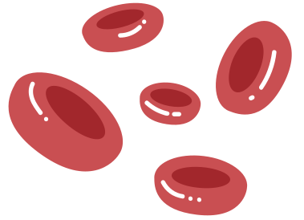

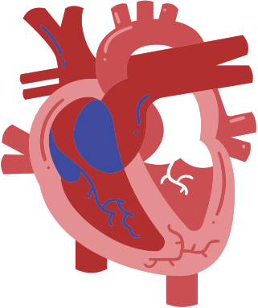
Risk Factors Decoded: A Predictive Model for Diabetes
By: Joe Ortiz, Max Valladolid, and Zuleyka Benavides

Slide 2
Data Overview
Contains 253,680 rows (patients) and 22 columns (indicators)
Diabetes Type: No Diabetes = 0, Diabetes = 1.
Includes health indicators that may be linked to diabetes.
Data was collected via surveys to get health indicators in the year 2015.
Data consist of 141,974 Females and 111,706 Males.
No missing values!
2
Notes:
rows are patients
columns are indicators

Slide 3


Health Indicators
Health Conditions:
High Blood Pressure, High Cholesterol, Stroke, Heart Disease
General Health Indicators:
BMI, General Health Rating, Mental & Physical Health Days
Lifestyle Factors:
Smoking, Physical Activity, Alcohol Consumption, Diet (Fruits & Vegetables)
Demographics:
Age, Sex, Education, Income
3
Notes:
Only mention the 4 categories, no ned to get into the specifics of each of these

Slide 4


Questions
Can the data collected here provide accurate predictions of whether an individual has diabetes?
What risk factors are most impactful/predictive of an individual having diabetes?
4

Slide 5
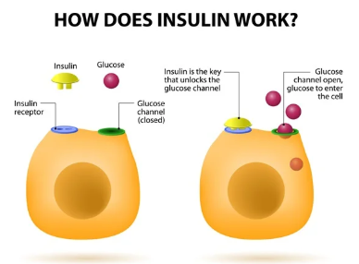


What is Diabetes?
Diabetes is a chronic disease where your body either can’t produce insulin or is unable to use the insulin made as effectively as needed. That leads to increased glucose (sugar levels) in the bloodstream.
5
Notes:
Insulin is necessary to break down glucose, so without it, it leads to high blood sugar levels.
After different foods are broken down into sugars during digestion, the sugars are then released into the bloodstream. This signals the pancreas to release insulin. Insulin helps enable cells within the body to use those sugars in the bloodstream for energy.

Slide 6
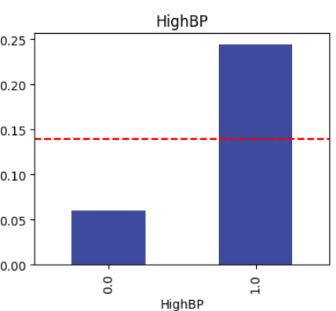
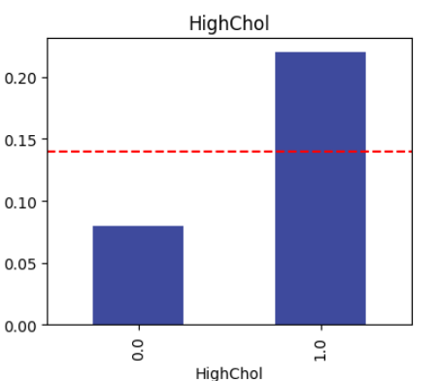
Big Factors
6
Notes:
Two of our biggest indicators were high cholesterol and hi bp.
High cholesterol leads to clogged arteries, which makes it harder for the heart to pump blood, which increases blood pressure. The increased blood sugar levels also lead to increased blood pressure, which is why we see both of them as our highest indicators in the data.

Slide 7
Why Blood Pressure and Cholesterol?
When glucose in the bloodstream is not properly regulated:
it can damage blood vessels, leading to stiffness and narrowing of the arteries. This increases the heart's workload, raising blood pressure.
it disrupts fat metabolism, leading to increased LDL (bad cholesterol). This promotes plaque buildup in the arteries, increasing the risk of high cholesterol.
High cholesterol causes plaque buildup in the arteries, making them narrow and stiff, which increases blood pressure.
7
Notes:
Two of our biggest indicators were high cholesterol and hi bp.
High cholesterol leads to clogged arteries, which makes it harder for the heart to pump blood, which increases blood pressure. The increased blood sugar levels also lead to increased blood pressure, which is why we see both of them as our highest indicators in the data.

Slide 8


Big Factors
Having High Blood Pressure and High Cholesterol leads to significantly higher probability of having Diabetes
1
Average rate of diabetes
Inversely Not Having High Blood Pressure and High Cholesterol leads to significantly LOWER probability of having Diabetes
2
8
Notes:
Two of our biggest indicators were high cholesterol and hi bp.
High cholesterol leads to clogged arteries, which makes it harder for the heart to pump blood, which increases blood pressure. The increased blood sugar levels also lead to increased blood pressure, which is why we see both of them as our highest indicators in the data.

Slide 9
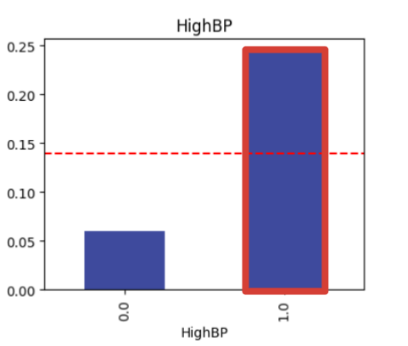
Big Factors
Having High Blood Pressure and High Cholesterol leads to significantly higher probability of having Diabetes
1
Inversely Not Having High Blood Pressure and High Cholesterol leads to significantly LOWER probability of having Diabetes
2
9

Slide 10
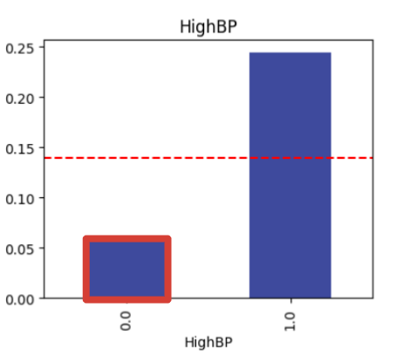
Big Factors
Having High Blood Pressure and High Cholesterol leads to significantly higher probability of having Diabetes
1
Inversely Not Having High Blood Pressure and High Cholesterol leads to significantly LOWER probability of having Diabetes
2
10

Slide 11
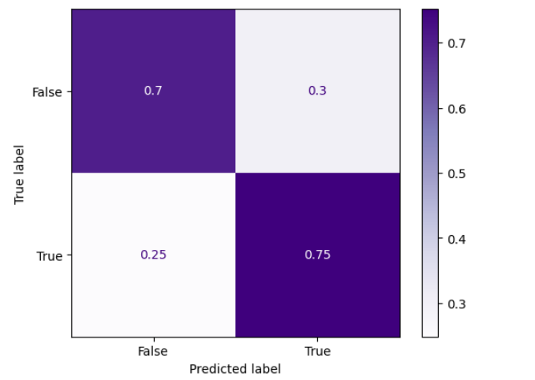
Correlation Matrix
Accuracy Score:
0.72
11
Notes:
Accuracy score is how accurate the model is at correctly predicting whether someone will be diabetic or not

Slide 12
Correlation Matrix
The model does a decent job, but we need to look and see what is causing the false positives.
12

Slide 13

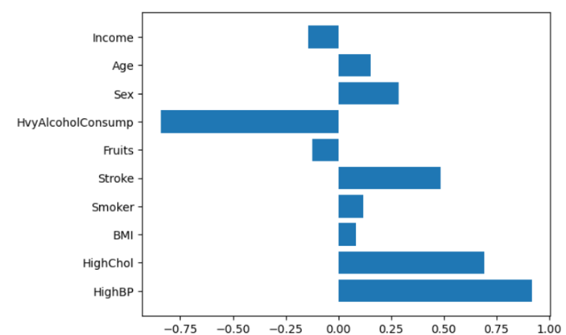
Coefficient of Logistic Regression Model
We expect HighChol and HighBP to have significant weight on prediction.
13

Slide 14
Coefficient of Logistic Regression Model
Heavy Alcohol Consumption stands out
14
Notes:
Diabetics avoid drinking alcohol because it can cause blood sugar levels to drop or spike, leading to health risks.

Slide 15
Coefficient of Logistic Regression Model
Alcohol prevents your liver from creating glucose, dropping the blood sugar.
15
Notes:
Diabetics avoid drinking alcohol because it can cause blood sugar levels to drop or spike, leading to health risks.

Slide 16
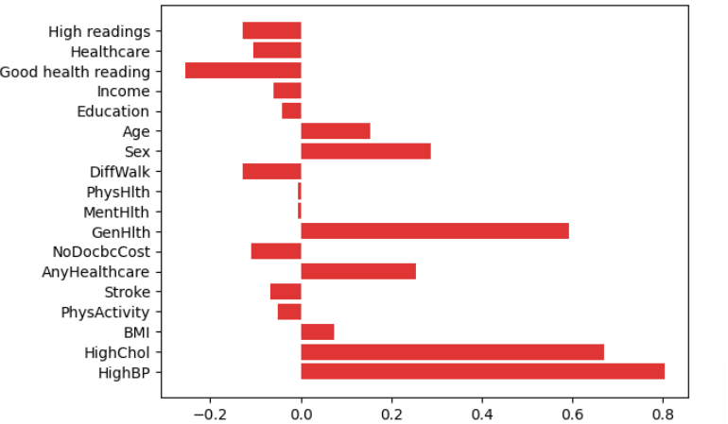
16
Notes:
Good health - heart disease, stroke, difficulty walking = false
healthcare - any healthcare and nodocbccost = false
all high readings - HighBP and HighChol

Slide 17
17
Notes:
Good health - heart disease, stroke, difficulty walking = false
healthcare - any healthcare and nodocbccost = false
all high readings - HighBP and HighChol

Slide 18
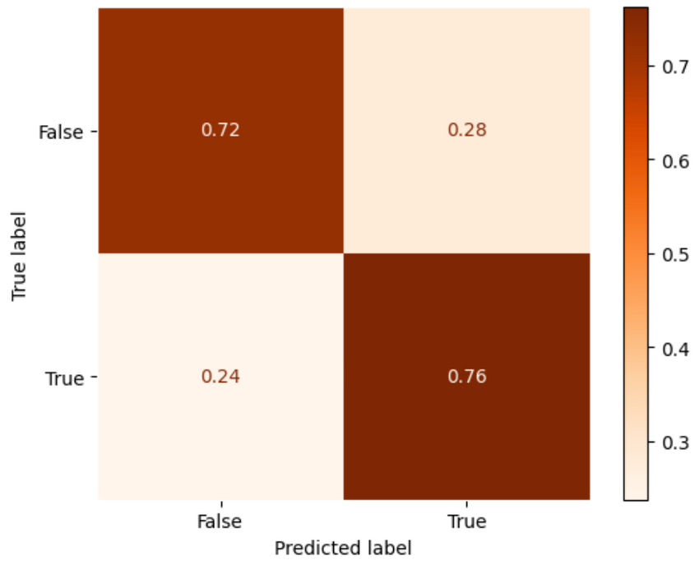
Increasing prediction
With our changes we manage to bring up our accuracy score:
18

Slide 19
Increasing prediction
With our changes we manage to bring up our accuracy score:
0.02
19

Slide 20
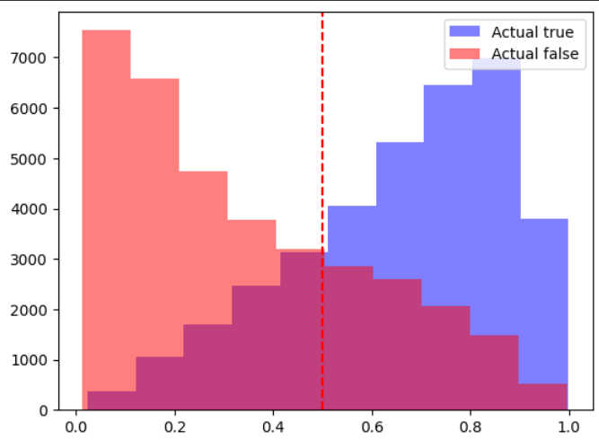

Class Separation Histogram
20

Slide 21
Class Separation Histogram
Incorrect pedictions model made
21

Slide 22
Demographic Information
Income
Gender
Age
Significant?
Significant?
Significant?
22
Notes:
Make the comment that we thought there could possibly b some differences between the major factors of males and females, but after looking at the data there is no statistical significance.
We expected income, gender, and age to play a big role, but they don’t significantly predict diabetes. On that note, our model shows that demographic features have low importance in correspondence to lifestyle and medical conditions.
Transition it over by saying, Instead, health factors like high blood pressure, cholesterol, and BMI are more important.

Slide 23
Demographic Information
Income
Gender
Age
NO
NO
NO
23
Notes:
Make the comment that we thought there could possibly b some differences between the major factors of males and females, but after looking at the data there is no statistical significance.
We expected gender, age, and income to play a big role, but they don’t significantly predict diabetes. On that note, our model shows
For questions, we made bar charts showing the correlation coefficients for each category, and between them all there were no statistically significant

Slide 24
Conclusion
Can the data collected here provide accurate predictions of whether an individual has diabetes?
What risk factors are most impactful/predictive of an individual having diabetes?
24

Slide 25
Conclusion
Can the data collected here provide accurate predictions of whether an individual has diabetes?
Yes, up to 74% of predictions are accurate
What risk factors are most impactful/predictive of an individual having diabetes?
25
Notes:
High BP and high cholesterol were the two factors that contributed to a diabetes prediction
and general health was the biggest factor that contributed to someone being predicted to not have diabetes.

Slide 26
Conclusion
Can the data collected here provide accurate predictions of whether an individual has diabetes?
Yes, up to 74% of predictions are accurate
What risk factors are most impactful/predictive of an individual having diabetes?
High BP
High Cholesterol
General Health
26
Notes:
High BP and high cholesterol were the two factors that contributed to a diabetes prediction
and general health was the biggest factor that contributed to someone being predicted to not have diabetes.

Slide 27







Why 74%?
Genetics & Family History
Medication Use
Certain medications affect blood sugar and cholesterol.
Genetics play a major role in diabetes risk because of inherited factors.
Direct Glucose Measurements
Diet Details
Provides a direct assessment of how the body processes sugar. Directly indicates diabetes, while other factors suggest risk.
Sugar and carb intake, directly affect blood glucose levels.
27
Notes:
- Sugar and carb intake directly affect blood glucose levels, impacting insulin response and diabetes risk. Excess intake can lead to insulin resistance, spiking blood sugar and increasing the likelihood of developing diabetes. Without this data, a model misses a key driver of the disease.
- inherited factors affecting insulin production, metabolism, and resistance.

Slide 28
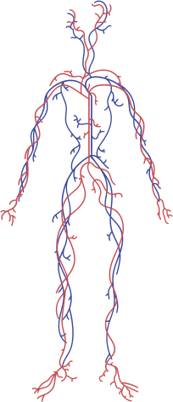

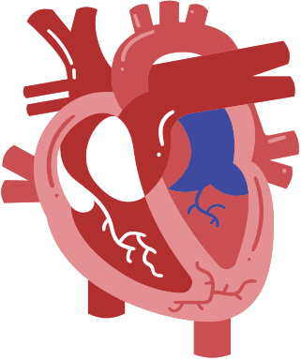
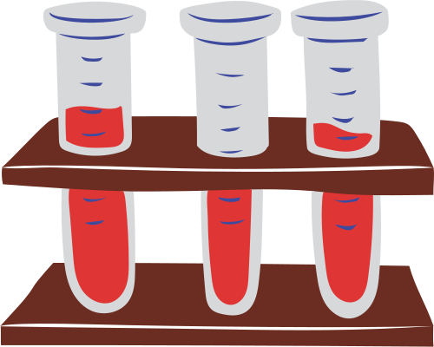

Questions?
28

